Slide 1
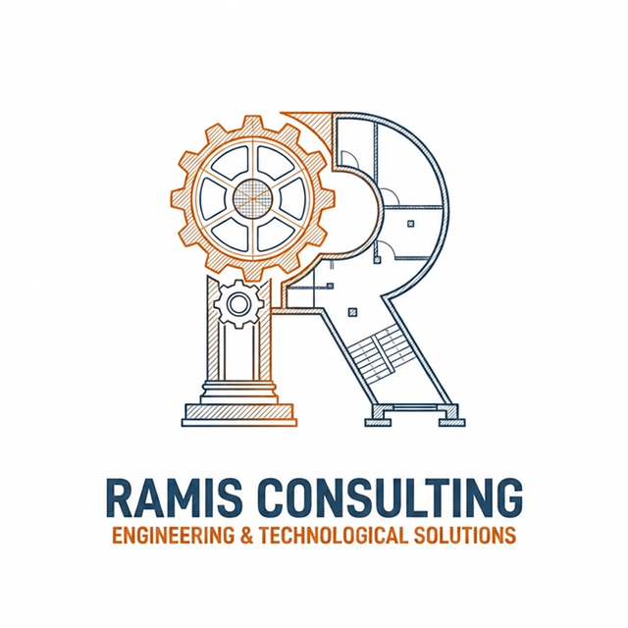
RAMIS.
Reliability, Availability, & Maintainability Engineering Consulting
Stop Firefighting.
Start Predicting.
Transforming West African Industrial Operations through Data-Driven Reliability Engineering
Notes:
Good morning/afternoon everyone, and thank you for joining me. Today, I want to talk about a critical shift in how we manage heavy industrial assets. In West Africa, operations are often dominated by a 'reactive' mindset—fixing things only after they break. At RAMIS Consulting, our mission is to change this narrative. We want to move you from constant firefighting to proactive, data-driven predicting. Over the next few slides, I will walk you through who we are, what we do, and how we can partner with your organization to achieve world-class operational reliability and maximize your asset ROI.

Slide 2
The High Cost of Run-to-Failure
Why reactive maintenance is draining your profitability in West Africa
01
Unplanned Downtime
Critical assets like mills, crushers, and offshore pumps fail unexpectedly, halting production. Downtime costs in heavy sectors easily exceed $100K+ per hour/day.
02
OEM Dependency
Heavy reliance on overseas manufacturers creates long logistics lead times for spares and brings expensive foreign support rates, bloating your OPEX.
03
Reactive Culture
Maintenance crews operate in permanent 'firefighter' mode. Asset degradation goes unnoticed, leading to premature failures and destroyed capital ROI.
Notes:
Let's look at the realities of operating heavy industry in West Africa. Our environmental conditions are harsh—extreme humidity, heat, and dust. When key machinery fails unexpectedly, production stops. For a mining operation, a crusher breakdown costs hundreds of thousands of dollars a day. Adding to this is the supply chain reality: wait times for parts from OEMs can take weeks, and flying in specialists is incredibly expensive. Because of this, local maintenance crews are stuck in a cycle of reactive repairs. They are firefighters, not strategic planners. We founded RAMIS to change this dynamic.

Slide 3
Operate for Reliability
Tailored engineering frameworks to maximize asset uptime and maintenance efficiency
OPERATIONAL 01
Reliability-Centered Maintenance (RCM)
• Criticality Analysis (FMECA) to identify high-risk components.
• Maintenance strategy optimization (Preventive vs. Run-to-Failure).
• Root Cause Analysis (RCA) implementation for chronic failures.
OPERATIONAL 02
Predictive Maintenance (PdM)
• Vibration Analysis to detect imbalance, misalignment, and bearing wear.
• Infrared Thermography programs to spot electrical and mechanical hot-spots.
• Oil Analysis and Tribology protocols to monitor oil health.
OPERATIONAL 03
CMMS / EAM Data Optimization
• Asset Hierarchy restructuring according to ISO 14224.
• Bill of Materials (BOM) development to streamline part replacement.
• Standardized Failure Codes and maintenance KPI dashboards in SAP / Maximo.
Notes:
How do we combat run-to-failure? RAMIS delivers core operational services. First, Reliability-Centered Maintenance, or RCM. We don't just copy-paste OEM guidelines. We analyze failure modes and effects to design a customized maintenance strategy that focuses budget where it matters. Second, Predictive Maintenance. We implement vibration, thermal, and oil tribology technologies that tell us exactly what is happening inside your machines, allowing us to plan repairs during scheduled outages. Third, CMMS optimization. EAM tools like SAP or IBM Maximo are only as good as the data entered. We audit, clean, and structure your hierarchies and BOMs so your systems generate actionable insights.

Slide 4
Advanced Reliability Engineering
Physics-based modeling and statistical trend analysis to guarantee long-term asset performance
PREDICT PERFORMANCE. OPTIMIZE DESIGN.
RAM Modeling & Simulation
• System reliability, availability, and maintainability (RAM) forecasting.
• Build Reliability Block Diagrams (RBDs) and run Monte Carlo simulations.
• Optimize system architecture and redundancy configurations to eliminate single points of failure.
• Life Cycle Costing (LCC) to align engineering design choices with corporate NPV goals.
MEASURE IMPROVEMENT. PROVE RELIABILITY.
Reliability Growth Analysis
• Track failure rate and MTBF trends over time using math models (e.g., Crow-AMSAA, Duane).
• Verify and quantify reliability improvements during system commissioning and operation.
• Validate that maintenance strategies and modifications are yielding statistical performance gains.
• Differentiate between random, wear-out, and infant-mortality failure regimes with hard data.
Notes:
Moving beyond daily maintenance execution, RAMIS Consulting provides advanced analytical engineering. Under our RAM Modeling and Simulation pillar, our tag is 'Predict Performance. Optimize Design.' We build digital models and Reliability Block Diagrams of your plant systems. This allows us to simulate system availability before construction or expansion, helping you optimize redundancies and design out single points of failure. Under our Reliability Growth Analysis, our tag is 'Measure Improvement. Prove Reliability.' We use mathematical models like Crow-AMSAA to track failure trends over time. This proves with statistical certainty that your maintenance improvements are working, and quantifies your reliability gains so you can present clear results to the boardroom.

Slide 5
Engineered for West Africa's Key Sectors
Customized reliability strategies for high-capital, complex operations
Gold, Bauxite, Manganese, Lithium
Mining & Minerals
CHALLENGE
Severe environment wear; long lead times for Heavy Mobile Equipment (HME) spares.
RAMIS SOLUTION
Condition monitoring for crushers/mills, and HME fleet strategy optimization.
Offshore FPSOs & Processing Facilities
Oil & Gas (Offshore/Onshore)
CHALLENGE
Corrosion in marine environments; high logistics costs for offshore maintenance crews.
RAMIS SOLUTION
Risk-Based Inspection (RBI), Asset Integrity Management, and life-extension studies.
Thermal, Hydro, and Grid Infrastructure
Power Generation & Energy
CHALLENGE
Aging turbines; lack of actionable sensor data from legacy control systems.
RAMIS SOLUTION
RCM implementation to maximize grid availability and protect transformer lifecycles.
Notes:
We do not believe in one-size-fits-all engineering. Our frameworks are customized. For Mining and Minerals, a key region industry, operations struggle with environmental wear (dust/moisture) and massive parts logistics delay. We optimize their Heavy Mobile Equipment fleets to increase availability. In offshore Oil & Gas, where safety and environment are critical, our focus is Risk-Based Inspection, Asset Integrity Management, and extension studies. In Power, we optimize turbine and transformer availability to prevent grid fluctuations.

Slide 6
Building Local Capacity: RAM Mastery
Upskilling your workforce to drive and sustain a reliability culture
We don't just consult; we transfer capability.
True reliability cannot be sustained by external consultants alone. It must be embedded into the daily culture of your local workforce. Our flagship RAM Mastery Certification Program is designed to transition your engineers from reactive firefighters to strategic asset managers.
Empower your team. Lower external consultant OPEX. Build sustainable local capacity.
RAM Mastery Modules
• Reliability & Availability Engineering Principles
• Maintainability Frameworks (RCM & FMEA/FMECA)
• Life Cycle Costing (LCC) and CAPEX vs OPEX Analysis
• Root Cause Analysis (RCA) - 5-Why, Fishbone, Fault Tree
• Reliability Dashboard & KPI Design (SAP PM, Maximo)
Notes:
We are proud of our focus on capacity building. Many international consulting firms will write a report and leave, and the client slips right back into run-to-failure. RAMIS does the opposite. We deliver the RAM Mastery Certification Program. We train your on-site engineering and planning team on advanced topics: reliability calculation, criticality analysis, life cycle costing, and root cause methods. We build long-term local capacity, saving you money on foreign expert rates over time.

Slide 7
Delivering Tangible Value & ROI
Reliability engineering is a high-yield business investment, not an expense
-35%
Reduction in Unplanned Downtime
Average improvement realized within the first 12 months of RCM strategy rollout.
-20%
Maintenance OPEX Savings
By shifting from emergency reactive work to structured PM/PdM workflows.
+15%
Asset Life Expectancy
Extended service life for heavy industrial equipment through targeted integrity practices.
100%
Clean, Actionable Asset Data
Fully audited, normalized, and functional CMMS database structures.
Notes:
Let's talk numbers. Reliability is a financial investment. We are here to deliver measurable bottom-line value. Typically, when we partner with an industrial site, we target and deliver a 35% reduction in unplanned downtime in the first year. This frees up production capacity. Second, we cut maintenance OPEX by 20% through optimizing spare parts inventory and reducing emergency callouts. Third, assets last 15% longer, saving millions in CAPEX. And fourth, your databases become fully optimized asset intelligence tools.

Slide 8
The RAMIS Advantage
Why we are the preferred partner for regional industrial leaders
01
Deep Regional Expertise
We understand the logistical bottlenecks, port processes, local supply chain constraints, and the tropical environmental realities of West Africa.
02
World-Class Team
Our leadership comprises certified reliability consultants and PhDs (Dr. Eric Gbadam, Charles Duah, Dr. Joshua Afari) with decades of heavy industry experience.
03
Quantitative Science
We rely on rigorous mathematical modelling, reliability forecasting, and the physics of failure, eliminating guesswork and vendor-biased advice.
Notes:
Why choose us over a generic international consultancy? Three key reasons. First, we are local and present. We understand the West African environment, logistics, and port dynamics. Second, our team. Our leadership includes Dr. Eric Gbadam, Charles Duah, and Dr. Joshua Afari. We bring academic credentials and extensive field experience in mining and offshore systems. Third, we are scientific. We model the math of reliability and physics of failure. We are independent of any OEM, so our recommendations focus solely on your best interest.

Slide 9

Your Path to Reliability Excellence
Let's work together to eliminate downtime and maximize your returns
PHASE 1: Diagnostic RAM Audit
Evaluate asset conditions, audit CMMS data, and highlight quick wins.
Get Started Today
Book a free 30-minute diagnostic session to assess your current reliability bottlenecks.
EMAIL: consult@ramisconsult.com
WEB: ramisconsult.com
WHATSAPP: +1 385-246-7875
PHASE 2: Clean & Optimize Strategy
Align maintenance plans to failure modes and clean critical data.
SCAN TO AUDIT
PHASE 3: Scale & Sustain Operations
Deploy predictive monitoring and certify teams with RAM Mastery.
Notes:
How do we begin? The process is simple. We start with a low-impact diagnostic RAM Audit. This evaluates your current equipment status, maintenance records, and culture. We identify quick wins. Second, we clean and optimize your CMMS data and strategies. Third, we scale and sustain by deploying PdM programs and certifying your teams. I invite you to book a free 30-minute diagnostic session. Scan the QR code on the screen or message us on WhatsApp at +1 385-246-7875. Let's work together to eliminate downtime and maximize your asset returns. Thank you, and I look forward to your questions.

